Slide 1


IMAGE GENERATOR
An Elementary Project in Machine Learning: Exploring the Generative Adversarial Network Model implemented in Keras/TensorFlow with Python
‘FaceGen’ by Andy Lee for MAIS202 (Fall 2020)

Slide 2

INTRO
LIBRARIES
01
02
PREPROCESSING
MODEL ARCHITECTURE
03
04
Basic description and introduction to GANs
Quick overview of the libraries used
Process of preparing dataset
Details of the GAN model architecture
DIFFICULTIES
RESULTS
05
Various problems encountered during training
06
Generated images and statistics from the model

Slide 3
01
INTRO
Basic description and introduction to GANs

Slide 4

ABOUT GANs
A Generative Adversarial Network (GAN) is a form of Nerual Networks used in Machine Learning. The objective of a GAN is to be able to read in many training set instances, learn and analyze the underlying pattern between the various instances, and then generate a new piece of realistic data which resembles the instances in the training set.

Slide 5
HOW DOES A GAN LEARN?
DISCRIMINATOR
GENERATOR
A GAN is a system of two separate Convolutional Neural Networks (CNNs) known as the discriminator and the generator. CNNs are most commonly used for GANs as CNNs show exceptional performance for analyzing image data. The most common uses of GANs is to generate new images / videos.
A Discriminator is responsible for discriminating between real images and generated images
A Generator is reponsible for generating new images from random noise drawn from the latent space
VS
A GAN combines these two models and makes them compete: the Generator seeks to fool the Discriminator by making the samples more realistic, and the Discriminator seeks to accurately be able to tell the difference between a real sample and a fake sample.

Slide 6
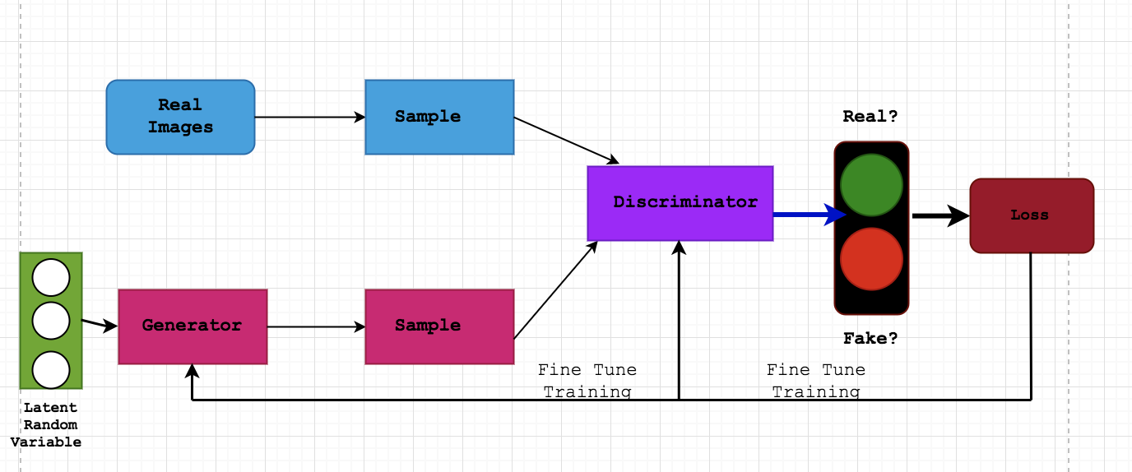
HIGH-LEVEL OVERVIEW OF GANS
Figure 1: High-level GAN architecture. Retrieved from https://towardsdatascience.com/drawing-architecure-building-deep-convolutional-gans-in-pytorch-5ed60348d43c.

Slide 7
ABOUT THIS PROJECT
The aim of this project is to utilize a Generative Adversarial Network to create realistic photos of human faces by training the model on CelebA dataset of celebrity faces.

Slide 8
02
LIBRARIES
Quick overview of the libraries used

Slide 9
USED LIBRARIES
OS
PIL
NUMPY
PANDAS
MATPLOTLIB
KERAS
Python built-in library - used for working with paths to images and datasets
Image Processing library - used mainly to preprocess the dataset
One of the core libraries always used in ML – used to manipulate image data in the form of nparrays
Library often used when working with .csv files – used to preprocess the dataset
Plotting library - used mainly to display resulting photos in a subplot
One of the most popular libraries used to create Neural Networks – used extensively to create models

Slide 10
03
PREPROCESSING
Process of preparing dataset

Slide 11
PREPROCESSING
Photos with people wearing hats or sunglasses were removed as it could confuse the elementary model
Each pixel was scaled from [0,255] to [-1,1] to fit the generator model
Filter
Pixel Scaling
Resize / Crop
Reduce Set Size
Finished
218x178 -> 80x80 Resized to decrease training time
Training set size reduced from over 180,000 images to 10,000 – mainly to reduce training time per epoch
Ready for training

Slide 12
10000 80x80 RGB IMAGES
in the training set after preprocessing in nparray form with shape (10000,80,80,3)

Slide 13
04
MODEL ARCHITECTURE
Details of the GAN model architecture

Slide 14
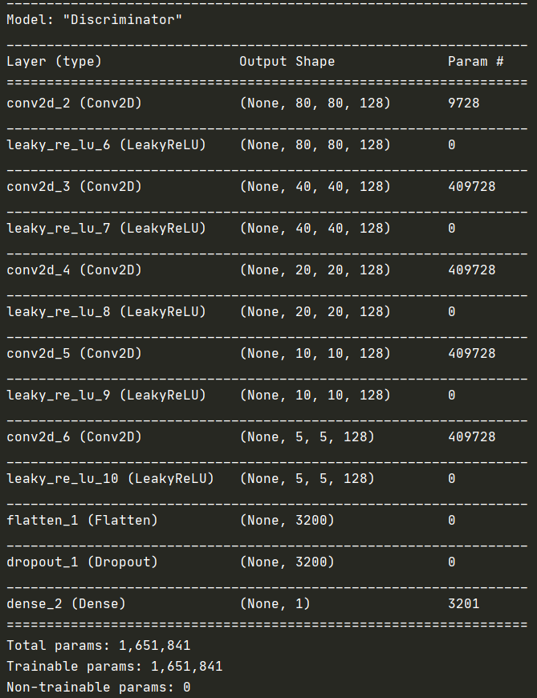
DISCRIMINATOR
For the Discriminator CNN model, a 5 Conv2D layer architecture was used. The number of filters, filter size, and stride was fixed at 128, 5x5, and 2 respectively.
Between each Conv2D layer, a LeakyReLU(alpha=0.2) layer was inserted as the activation function. Usage of either the LeakyReLU or the ReLU in CNNs are very common.
At the end the Dropout(0.4) layer was added to prevent overfitting and the Dense(1) was added since the discriminator’s output is binary (real or fake). In following, the loss function used was ‘binary-crossentropy’.
Adam(lr=0.0002) was the optimizer of choice, as it is the standard for many CNN models.
The hyperparameters were decided after various alterations. The chosen architecture provided the best balance between performance and speed.

Slide 15
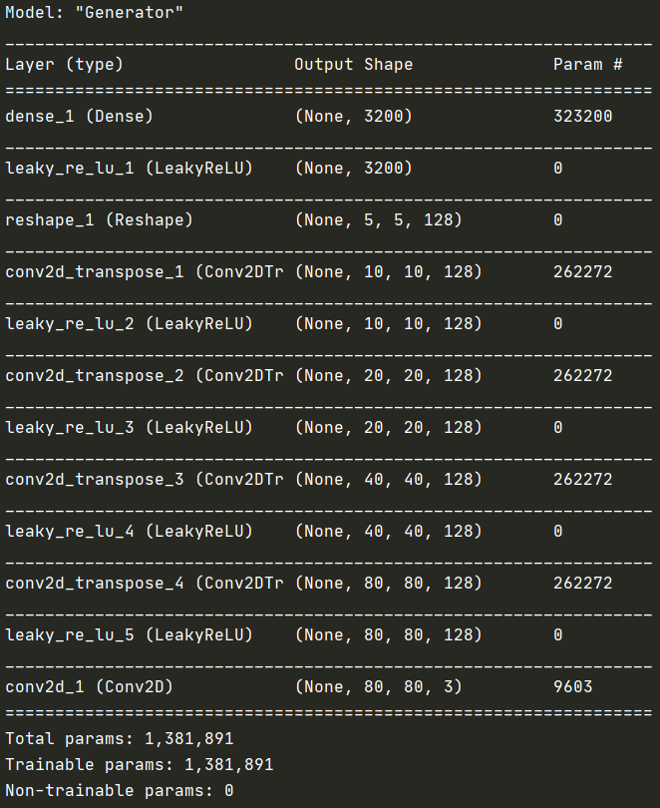
GENERATOR
For the Generator model, a Dense layer of 5x5x128 was used followed by 4 Conv2DTranspose layers architecture was used. The number of filters, filter size, and stride was fixed at 128, 4x4, and 2 respectively.
Between each Conv2DTranspose layer, a LeakyReLU(alpha=0.25) layer was inserted as the activation function.
The model works by generating a 5x5x128 sample then upscaling with each Conv2DTranspose layer to 80x80x128.
At the end a regular Conv2D turns the sample from 80x80x128 to a RGB image of shape 80x80x3.
The hyperparameters were decided after various alterations. The chosen architecture provided the best balance between performance and speed.

Slide 16
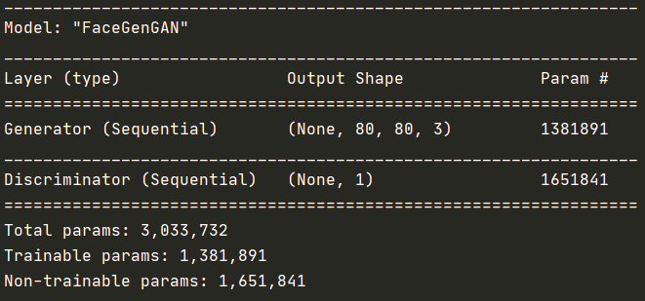
GAN
The GAN model architecture is very simple. It simply consists of the Generator and Discriminator models put together in sequence.
The Adam optimizer is used along with the ‘binary_crossentropy’ loss function.
The weights for the discriminator for set to not be trainable, since they will be trained separately by the discriminator model.

Slide 17
05
DIFFICULTIES
Various problems encountered during training

Slide 18
ENCOUNTERED PROBLEMS
TRAINING TIME
MODEL ARCHITECTURE
TRAINING INSTABILITY
The image resolution and training set size had to be reduced significantly from original plans in order to make training even feasible. With the original intended resolution of 160x160 and training set size of 180,000, the computer would often run out of memory or take forever to complete one epoch.
Varying the model architecture caused greater changes in the output then expected. Certain architectures with different layers or slightly different hyperparameters would often result in completely non-recognizable images or losses over 300,000. To find a working model architecture took the longest time.
Training the GAN model itself was a lot more instable than as expected. Often times, under the same architectural conditions, the results would differ greatly, with some runs generating human-like images whereas other runs would generate completely unrecognizable noise. Changing the model architecture and hyperparameters greatly allieviated this issue.

Slide 19
06
RESULTS
Generated images and statistics from the model

Slide 20
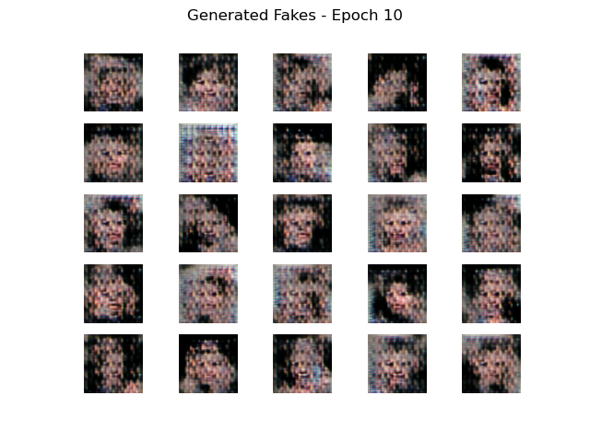
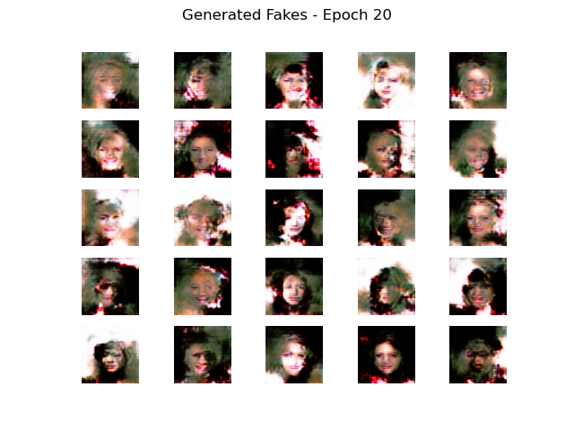
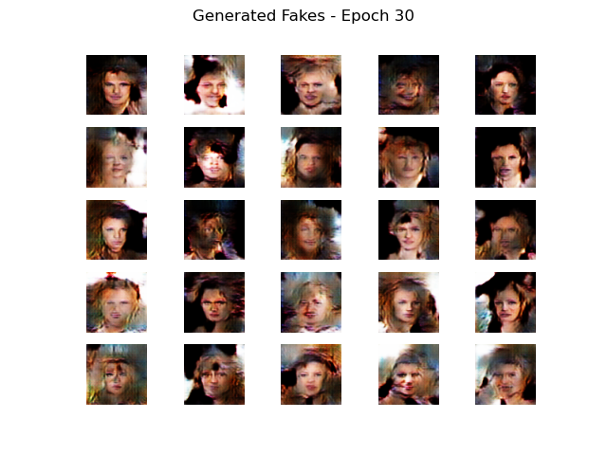
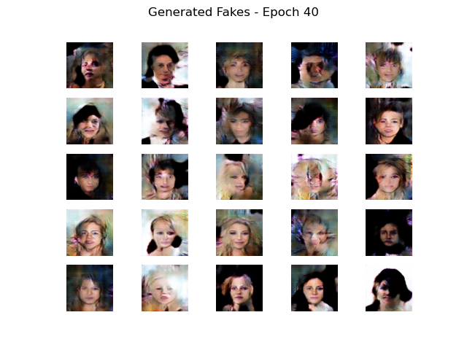
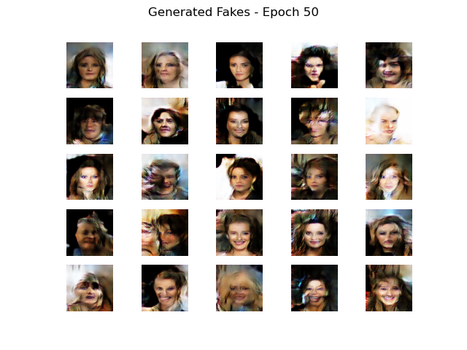
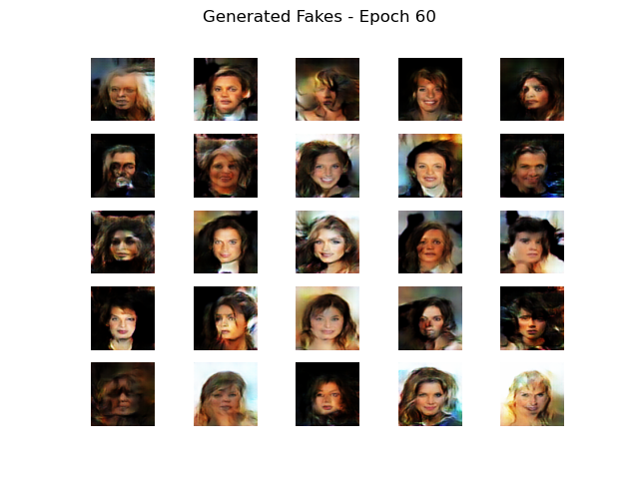
GENERATED PORTRAITS

Slide 21
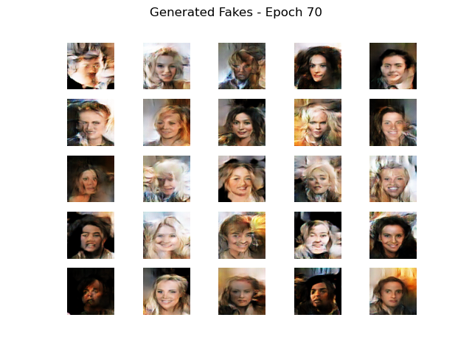
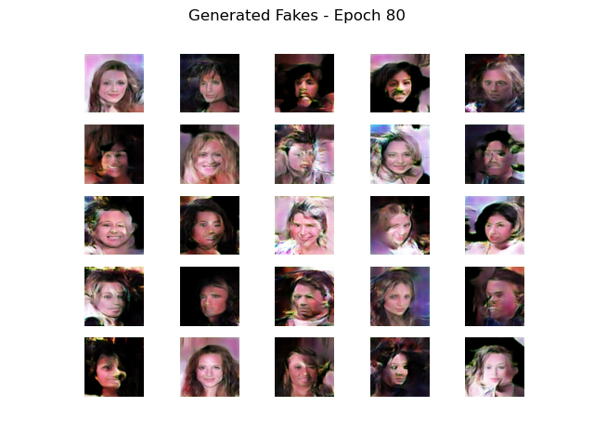
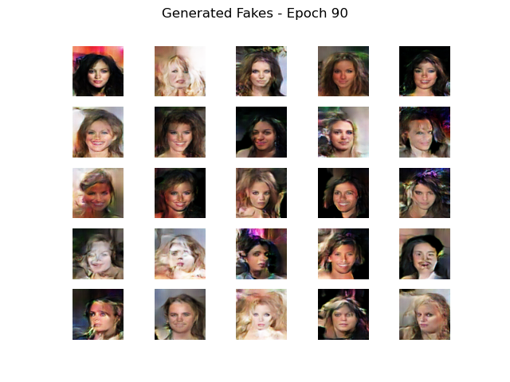
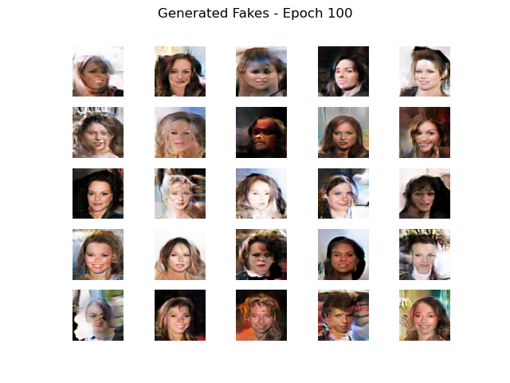
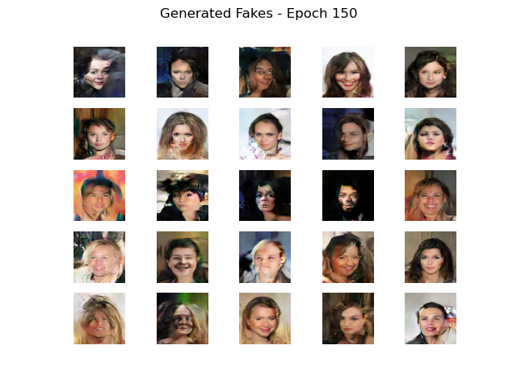
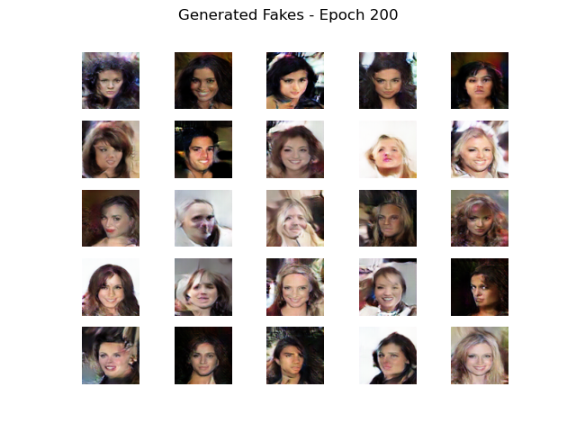
GENERATED PORTRAITS

Slide 22
GENERATED PORTRAITS – EPOCH 200
As expected, the model starts generating noise (epoch 10) . Then around epoch 30, the outlines of faces begin to show, with eyes, noses, and mouths in their relatively appropriate locations.
By epoch 60, the model seems to have learned what a “face” is at a high level, although there still exists many disfigured photos.
By epoch 100 and 150, the machine evolves to understand the fine details such as hair and background. Most photos still look very fake to the human eye.
By epoch 200, the machine becomes capable of outputting a couple of faces which are very realistic.

Slide 23
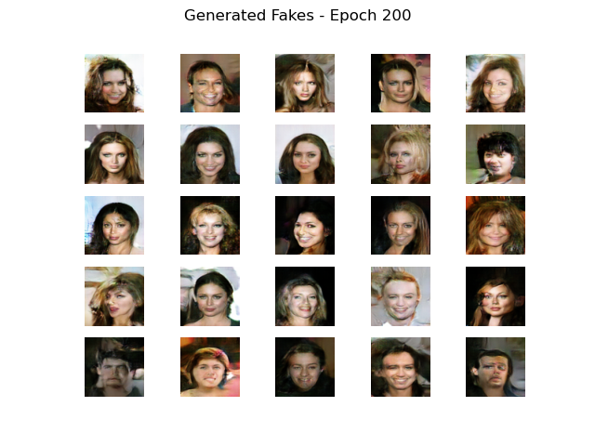
GENERATED PORTRAITS – EPOCH 200
However, not all photos are realistic. There still exists some photos which clearly look fake.
To generate hyper-realistic images the number of epochs, image resolution, and dataset size should be greatly increased. In addition, the model architecture should become more complicated and advanced in order to facilitate such a process.
One interesting point is that most of the generated outputs have “feminine” features even though the dataset was balanced in terms of gender. The reason for this phenomenon is unknown.

Slide 24
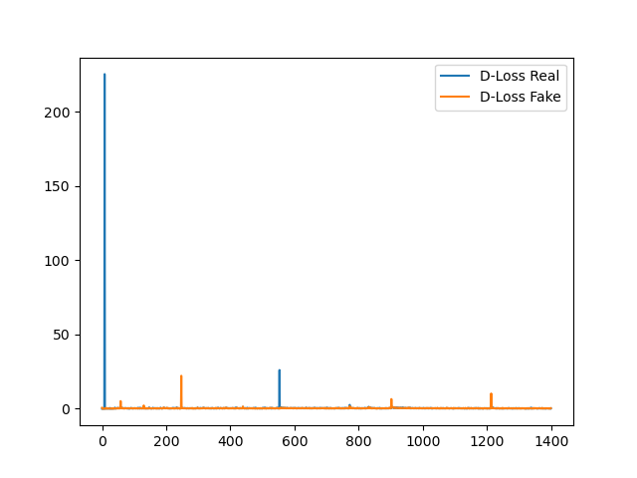
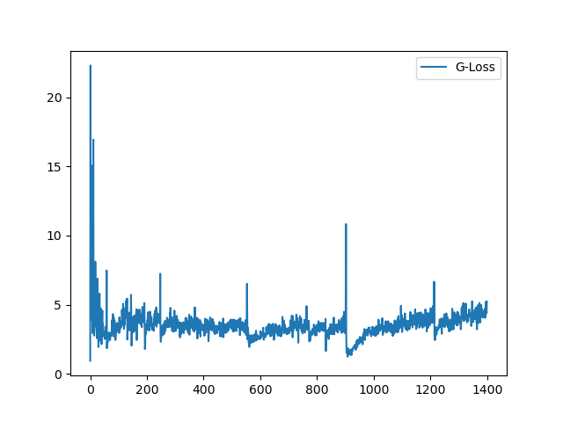
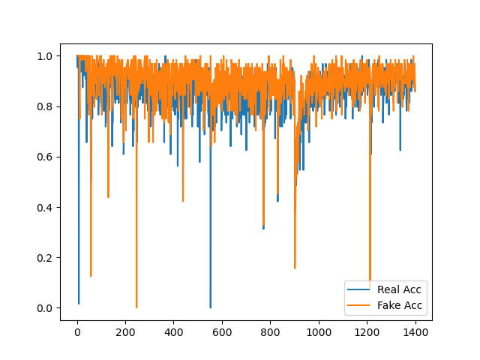
STATISTICS
DISCRIMINATOR LOSSES
GENERATOR LOSSES
DISCRIMINATOR ACCURACIES
The binary crossentroy losses on the generators show a clear pattern with decreasing variance. It settled around 3-5.
The binary crossentropy losses for the discriminators were started off very high but quickly settled to around 0.2-0.4. It is hard to recognize by this graph due to the outliers, however there was a gradual decline in loss over many epochs.
The discriminator’s accuracies remained around 85-95% for the 200 epochs. The discriminator became slightly less accurate at determining real photos from fake ones as the epochs progressed
*Data were sampled every 10 batches for 200 epochs.

Slide 25



CREDITS FOR SLIDESHOW TEMPLATE: This presentation template was created by Slidesgo, including icons by Flaticon, and inforgraphics & images by Freepik.

